Slide 1
Color Memory
a card based puzzle game

Slide 2
Goals & Targets
Given the strict timeline, we had to come up with a set of goals which we wish to achieve through this project.
Game Genre: Card based puzzle game
Game Objective: Match all the card pairs
Development Objectives: Minimalistic UI/UX
Simple intuitive gameplay
Natural and fluid animations
Unlockable cards and other items
Scoreboard, rewards and achievement system
Above all, a complete, playable and enjoyable game

Slide 3
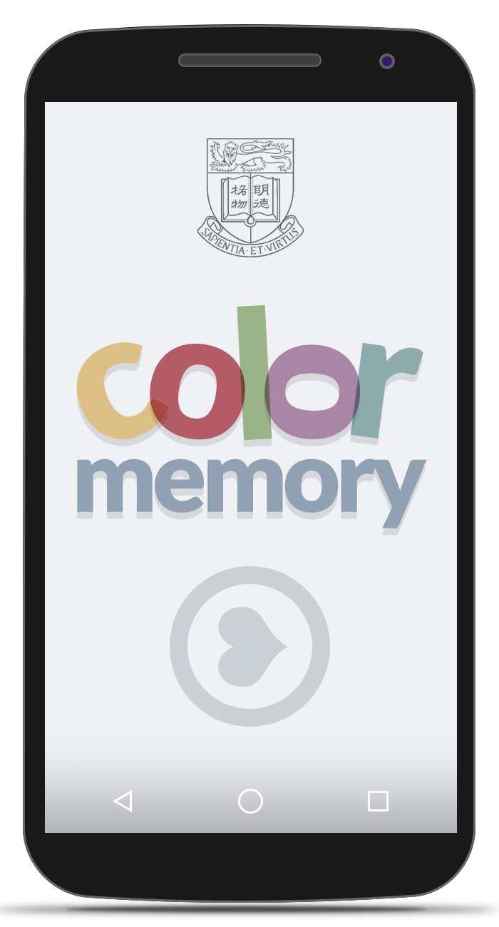
Concept Mockup
This is the first iteration of the game’s design and aesthetics. Some pointers about the design process:
In accordance to the brief, the HKU logo is placed on the landing page itself. The HKU logo has been redrawn with a wireframe look to fit the minimalism we are aiming for.
The game logo has been designed to make it both inviting with the use of colours, as well as interesting by introducing asymmetry.

Slide 4
Feature List: Design
Design Features: Intuitive Gestures
3D Card flip animations
Intent and fragment animations
Asset design for multiple devices and screen sizes
Colour Palette:
The colour palette is inspired from Base16: Ocean by Chris Kempson ‣ chriskempson.github.io/base16/#ocean
We plan to make both light and dark versions of the UI with the same colours.

Slide 5
Feature List: Gameplay
Game Features: Simple and addictive gameplay
SQLite based scoreboard and configurations
Multiple card packs – Available and Unlockable
Rewards feature based on combos which gives coins
Different game modes – Normal, Time Attack and Endless
Extra Features: Social sign in feature
Google Play integration

Slide 6
Technical Specifications
Platform: Android
Version: 4.1.x Jelly Bean
API: 16
Design Tools: Adobe Photoshop, Gimp
Development Tools: Eclipse ADT, Android Studio
Build Tools: Travis CI, Gradle, Maven

Slide 7
Potential Pitfalls
Some of the challenges that we may face:
Development Device: Since we do not own android devices, we have to work with
emulators, which can be slow, time consuming and often produces
unexpected results on actual devices.
Deployment Device: There are numerous android devices in the marketing of all sizes and
shapes. The aesthetics and performance can vary vastly from device to
device, and may even be an unpleasant experience in some.
Platform Dependency: We will be using Android API level 16. The current stable version is 22.
Even thought there are very less such devices with API lower than 16 in
the current market, there is still a chance that the user’s device may not
support the game.

Slide 8
Timeline
Jun 28 – Jul 03: Concept
Mockup design
Asset and resource creation
Jul 04 – Jul 17: Gameplay
Animations and gestures
Scoreboard, awards and achievements
Jul 18 – Jul 24: Testing
Unlockable items
Refinements and other extra features

Slide 9
Responsibilities
Rahul
Minimalist Designer
Rebellious Programmer
Documentation Ninja
Janssen
Resident Design Expert
Programming Guru
Documentation Apprentice
We have an unusually creative process of dividing responsibilities, and we are not sure whether it’s quantifiable.

Slide 10

Thank you
members:
Janssen Marwin Go 3035150696
Rahul Kumar Thakur 2013854618
github.com/rahul-rkt/ColorMemory

